Slide 1
How to Book Services on JSR Tax Services website

Slide 2
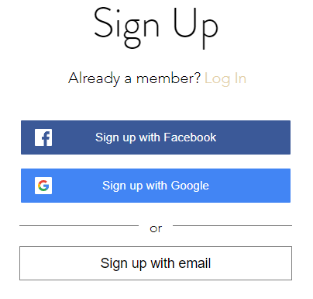
1. Log In
Go to www.JSRTaxServices.com
Click on Log in
Select your sign up choice
or Log in if already a member

Slide 3
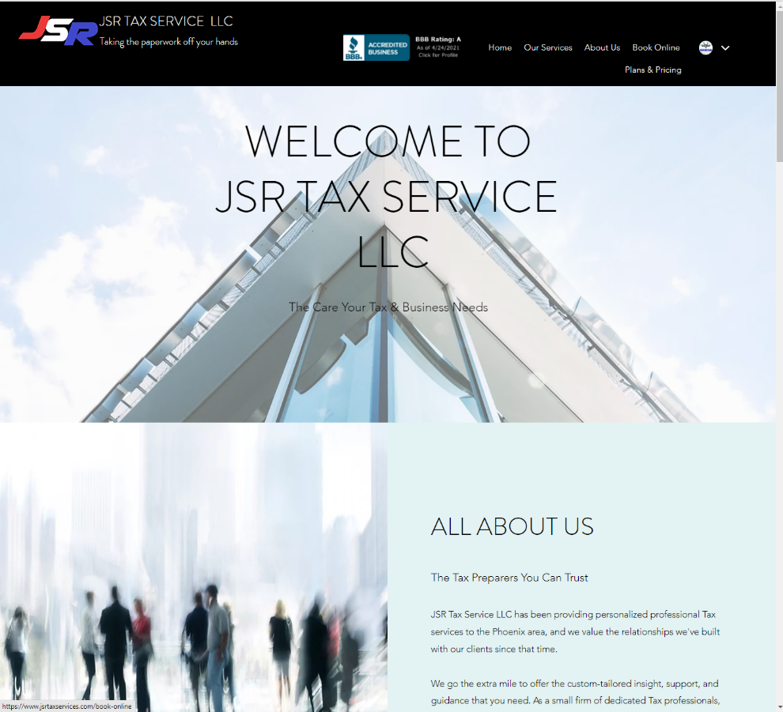
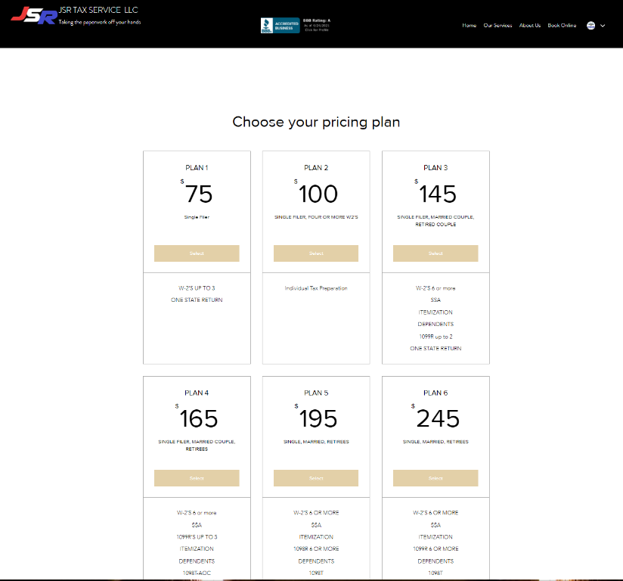
2. View Pricing Plans
Hover over Book Online until Plans and Pricing appear
Decide which Pricing Plan you like, do NOT click on Select

Slide 4
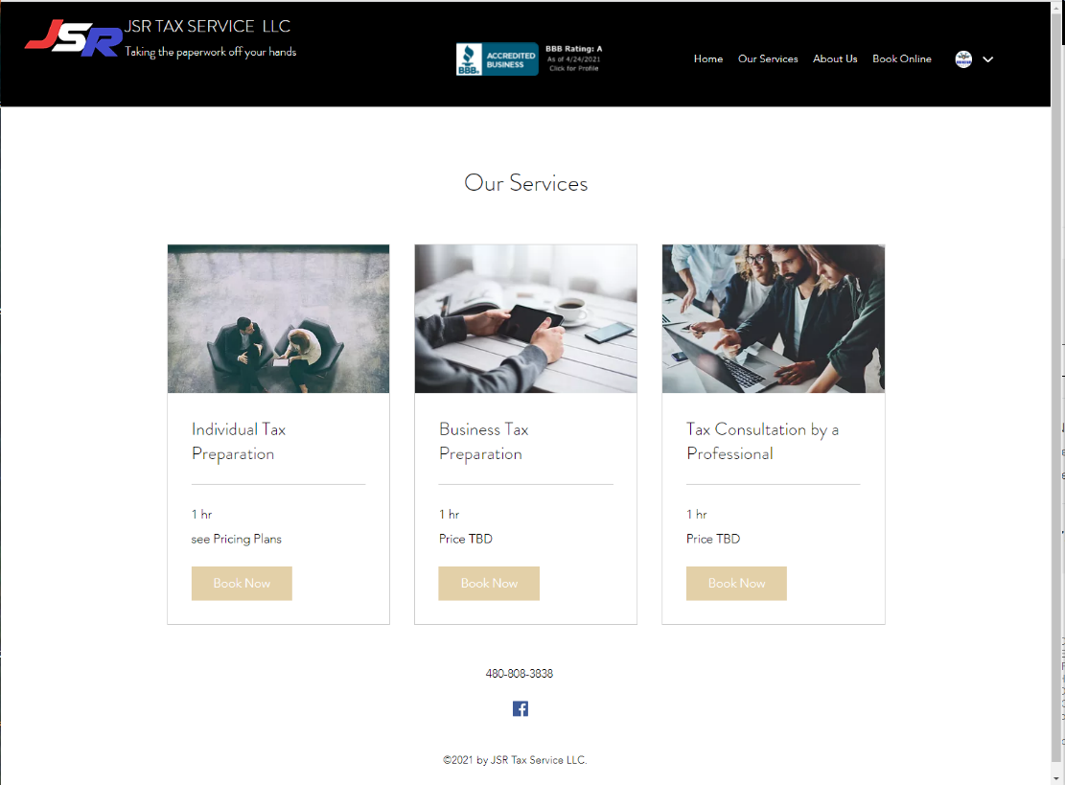
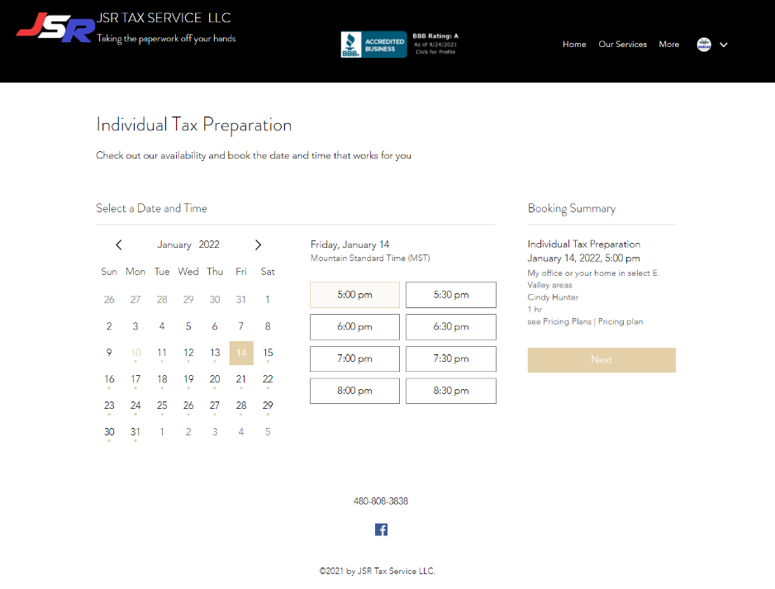
3. Book on Calendar
Select Our Services
Decide which Service you like
Then click on Book Now
Select Date and Time of your appointment, then click Next

Slide 5
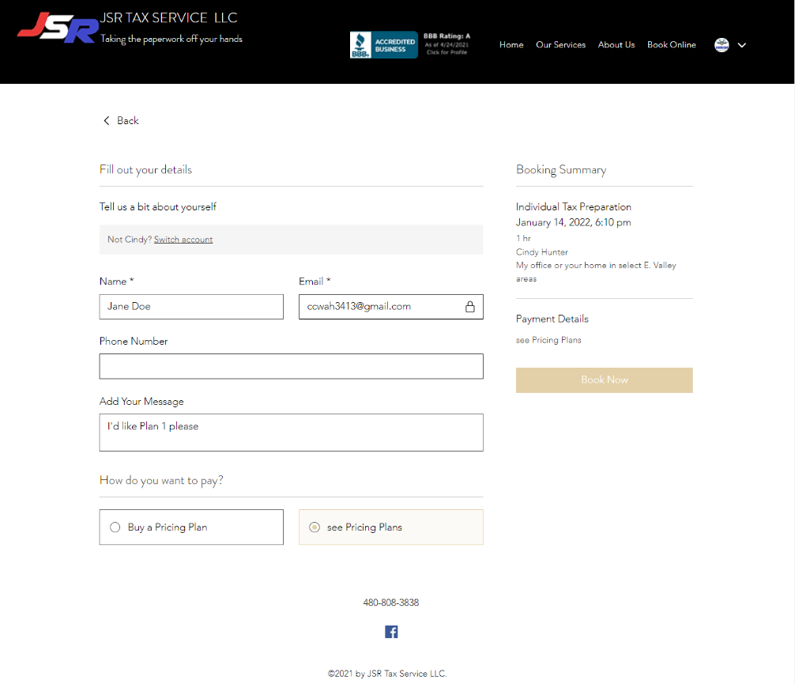
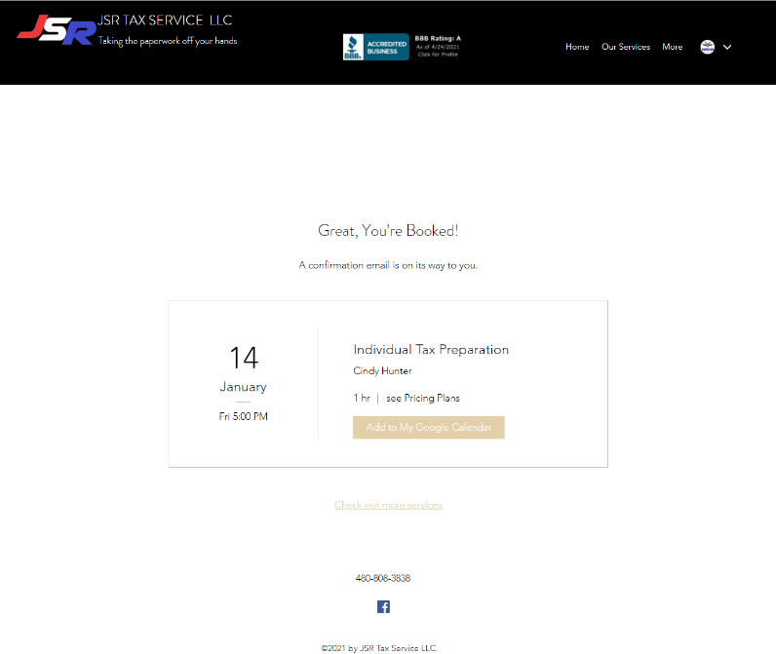
4. Fill in Form
Fill in Form, include which plan you decided on
then click on Book Now
janedoe@gmail.com
Here’s the confirmation.
If you have Google Calendar then
click Add to My Google Calendar

